Slide 1
The impact of the pandemic on gender equality
Presented by: Rasa, Adrija and Ema, II a.

Slide 2
TABLE OF CONTENTS
01
02
03
04
The definition of gender equality
Reasons for gender inequality
Actions taken against inequality
Conclusions

Slide 3
What is gender equality?
Gender equality, also known as sexual equality or equality of the sexes, is the state of equal ease of access to resources and opportunities regardless of gender, including economic participation and decision-making; and the state of valuing different behaviors, aspirations and needs equally, regardless of gender.

Slide 5
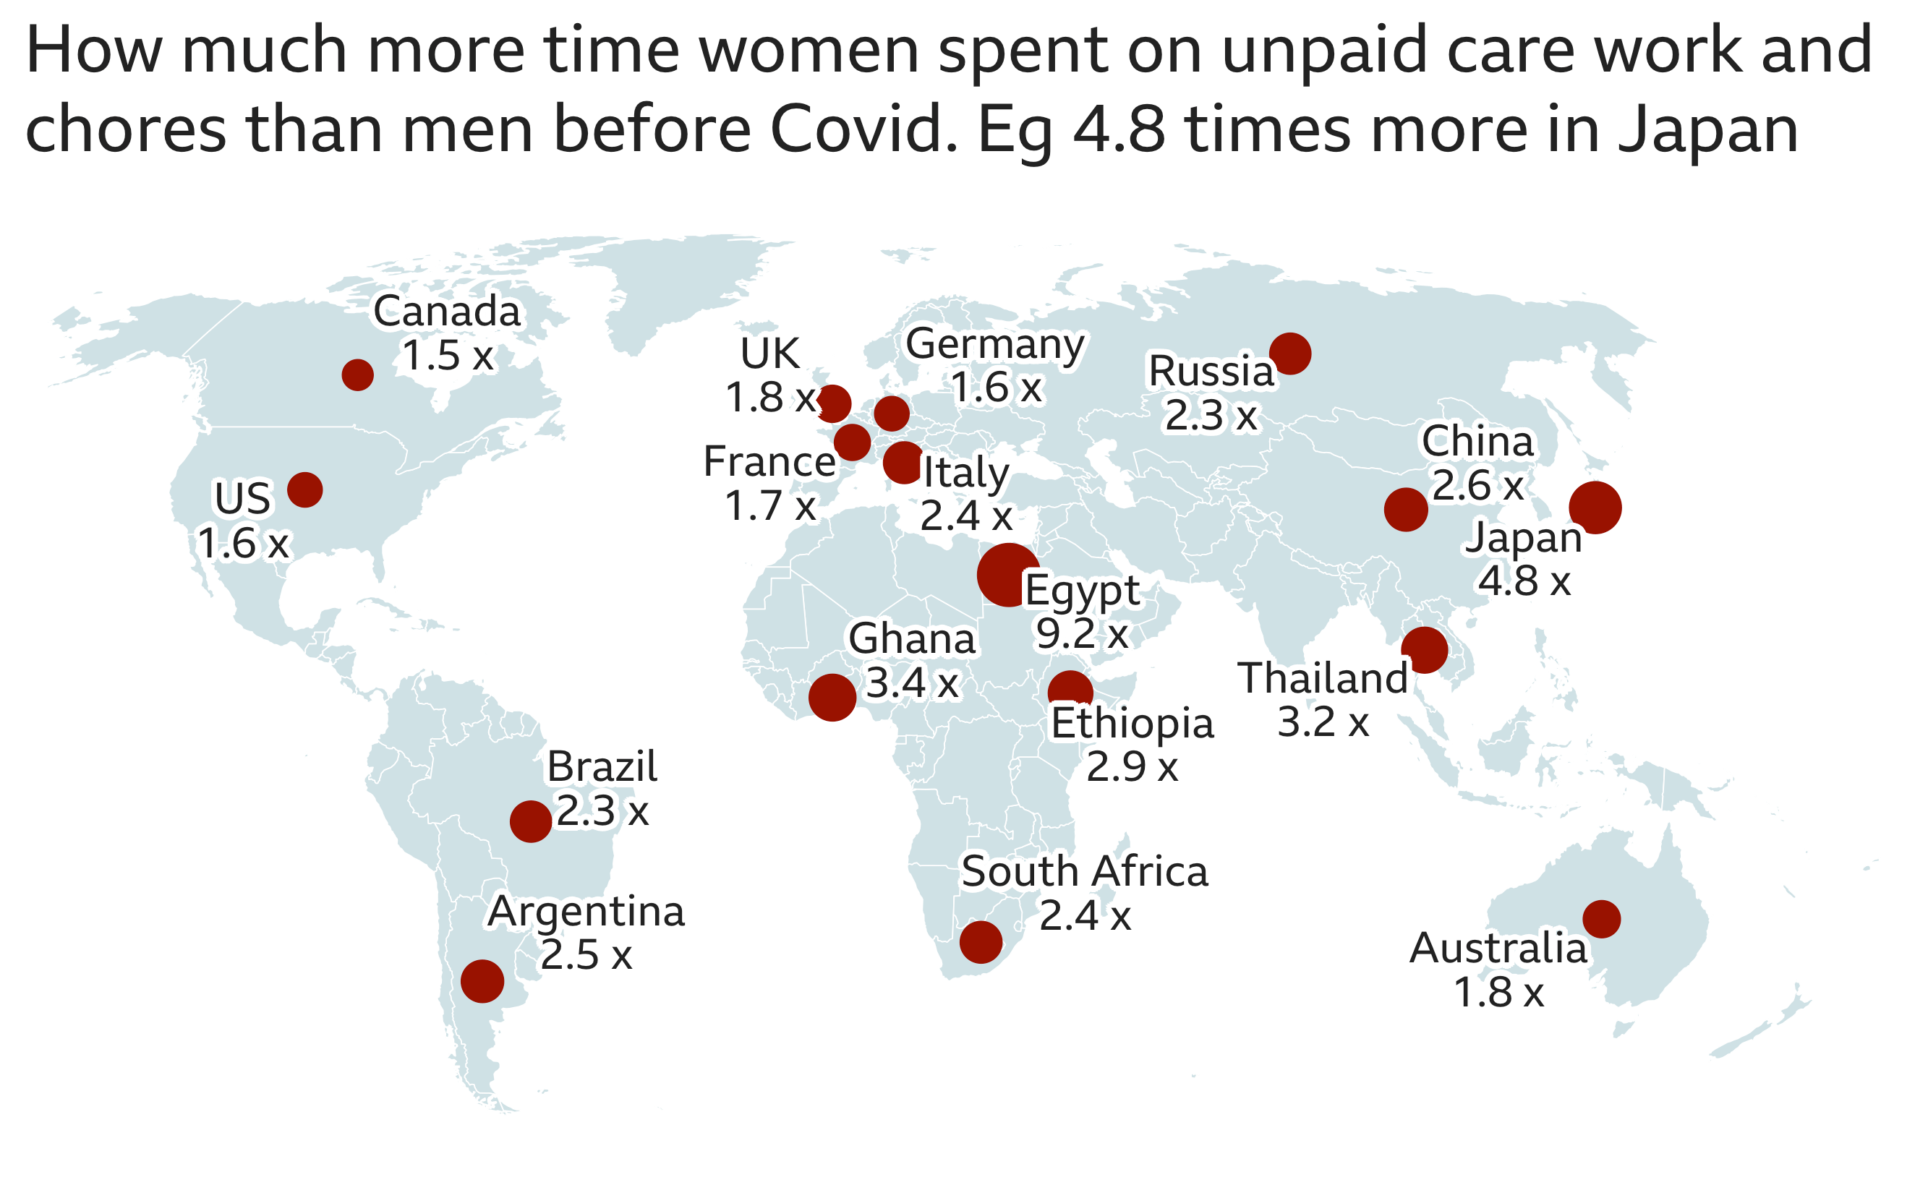

Slide 6
Reasons
1.
2.
In countries where social institutions discriminate highly against women, women’s role in society is restricted to reproductive and domestic functions, with women performing more unpaid care work than men.
Women tend to care more about the way their living space looks.

Slide 7
Actions taken against inequality
EU promotes a more equal sharing of parental leaves, an adequate public provision of childcare services and adequate company policies on flexible working time arrangements.

Slide 8
Conclusions:
The pandemic had an effect on the distribution of chores between the genders. Some sources imply that the work load for women has increased while others portray a different statistic which points out that time spent doing unpaid care work by women has decreased during the pandemic.

Slide 9
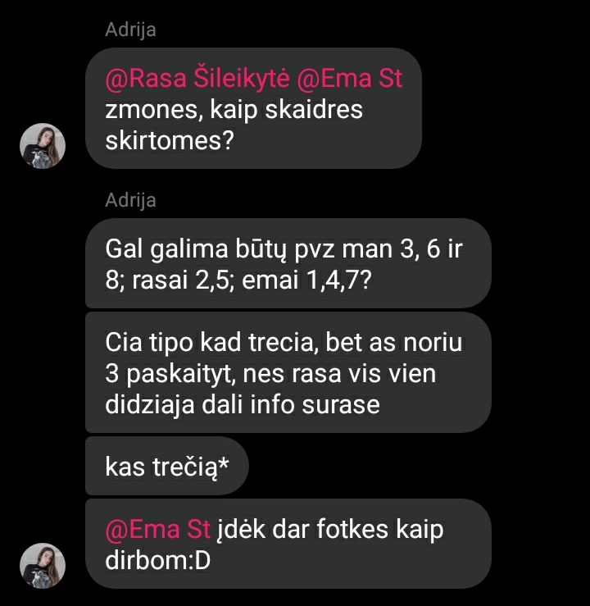
Proof of our teamwork

